Slide 1
Home Department
Govt. of Bihar
Grih Darshan
Designed and Developed By (NIC), Patna. BIHAR.

Slide 2
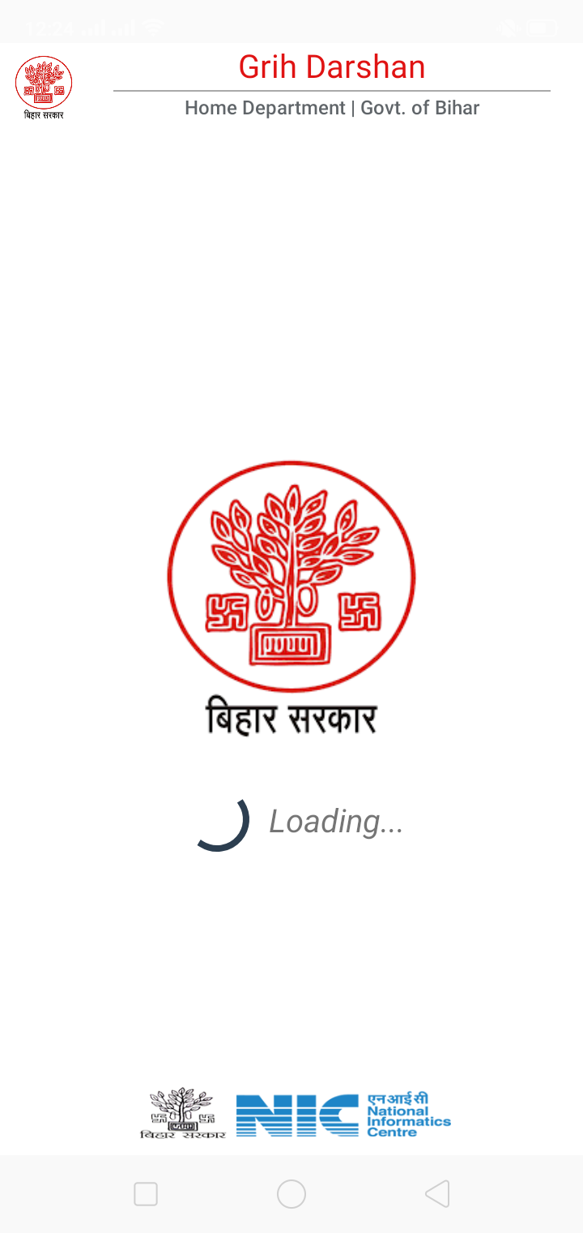
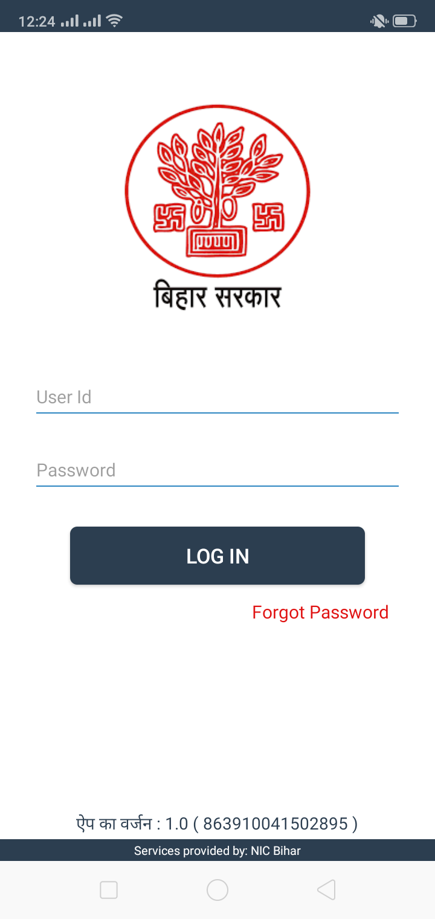
LOGIN Screen

Slide 3
POLICE STATION LOGIN

Slide 4
Signup Screen
This screen appear’s for first time login for Police Station to Update their Thana Details.

Slide 5
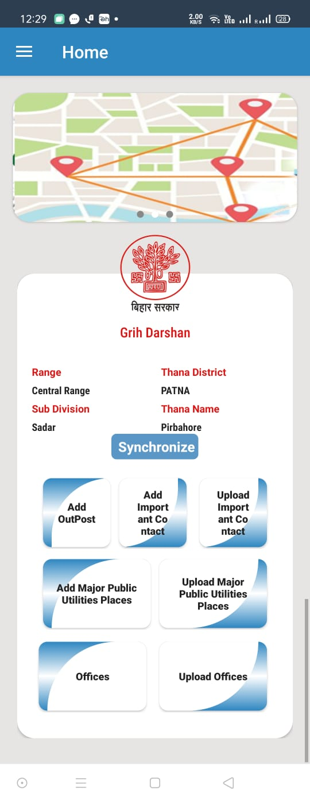
Home Screen
Click on Synchronize button to synchronize all master data from server.
Click This Button To Add New Major Public Utilities..
Click here to upload or remove locally inspected data..
Click here to add offices under Police Station and save in locally.

Slide 6
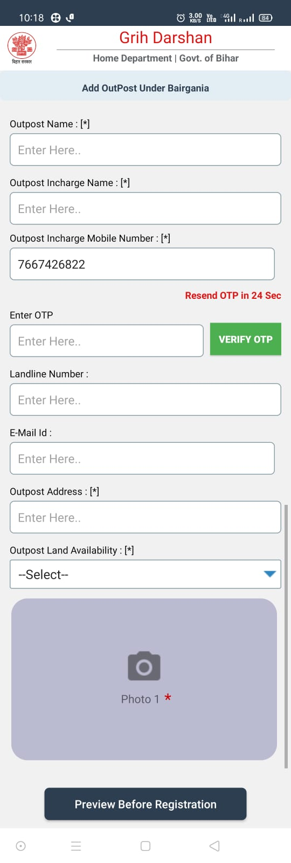
Add Outpost
Enter Otp Recieved on mobile and click on this button to verify Otp.

Slide 7
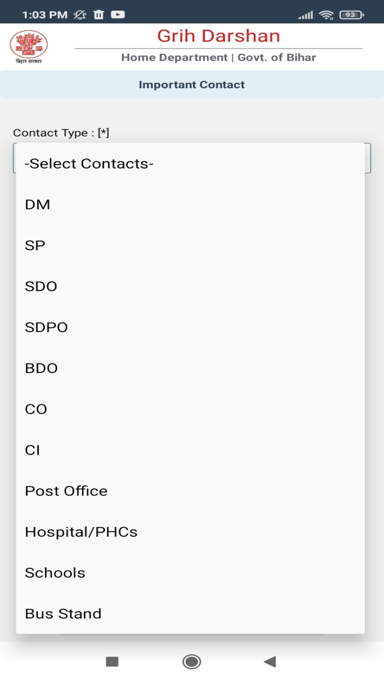
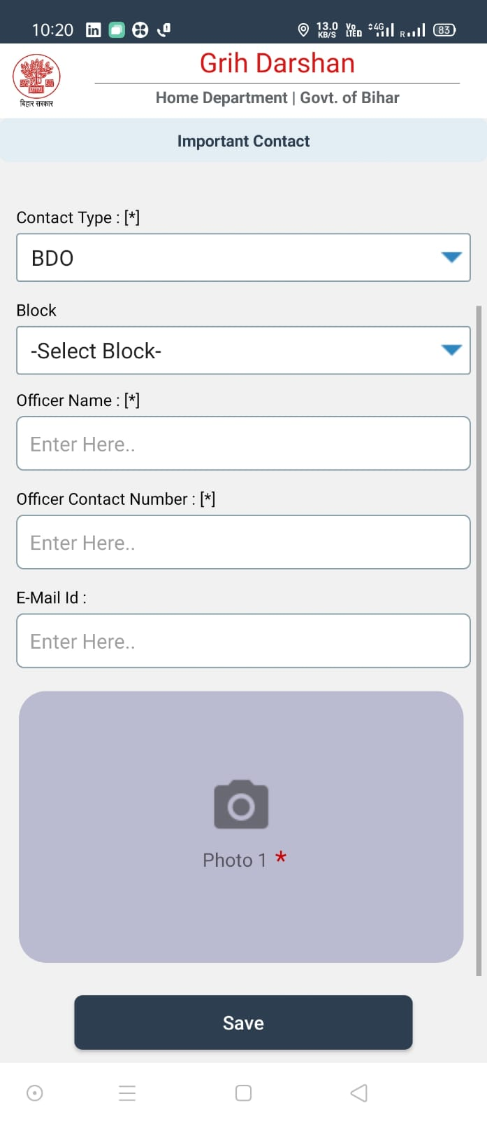
ADD Important Contacts
Choose Type Of Contact from dropdown menu and enter required field.
DM and SP Contact can only be added by Thana Under Which DM And SP Office Comes.

Slide 8
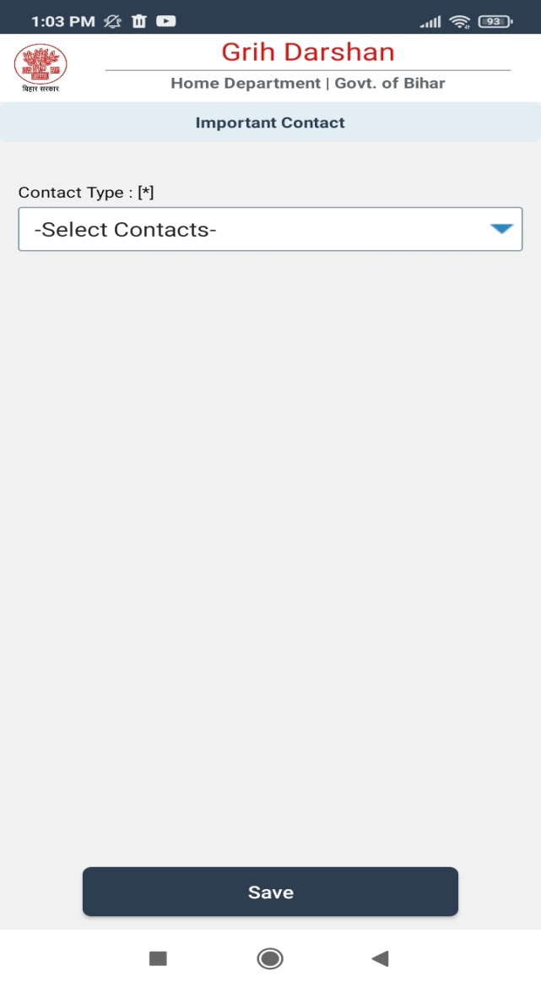
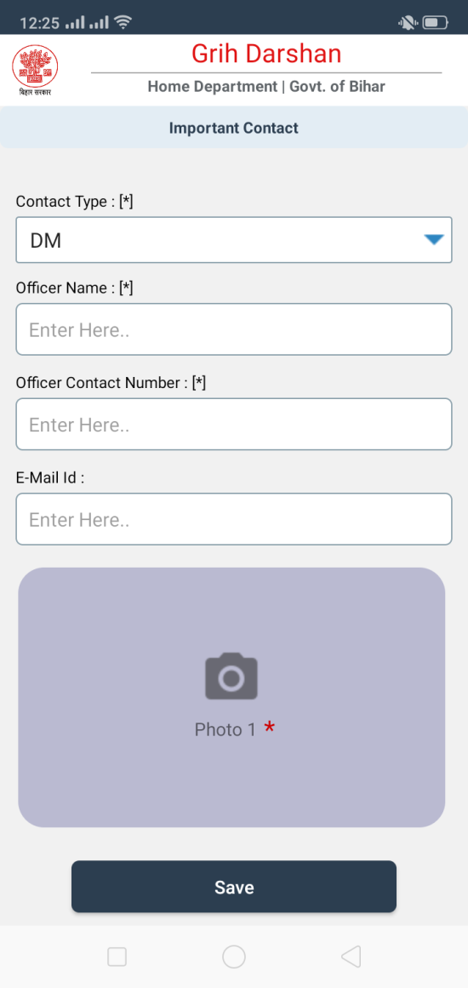
ADD Important Contacts

Slide 9
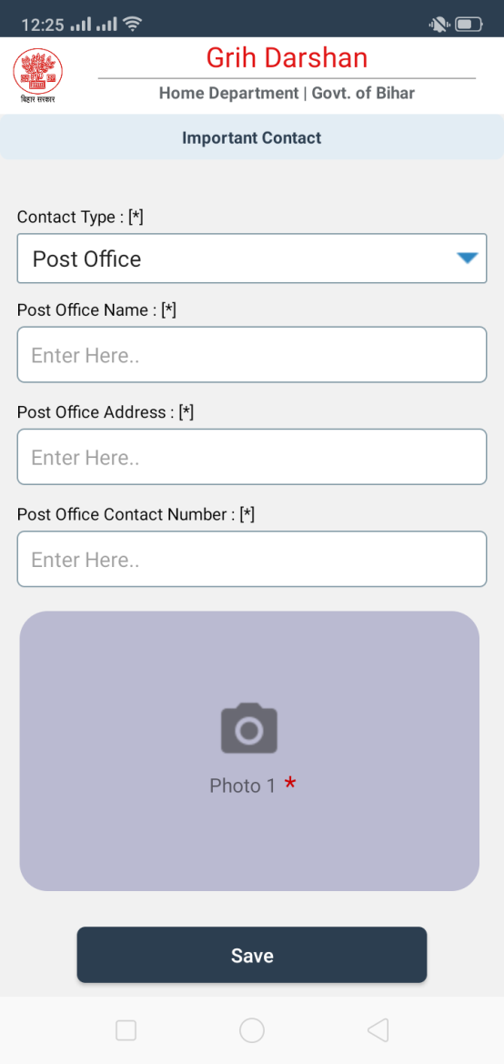
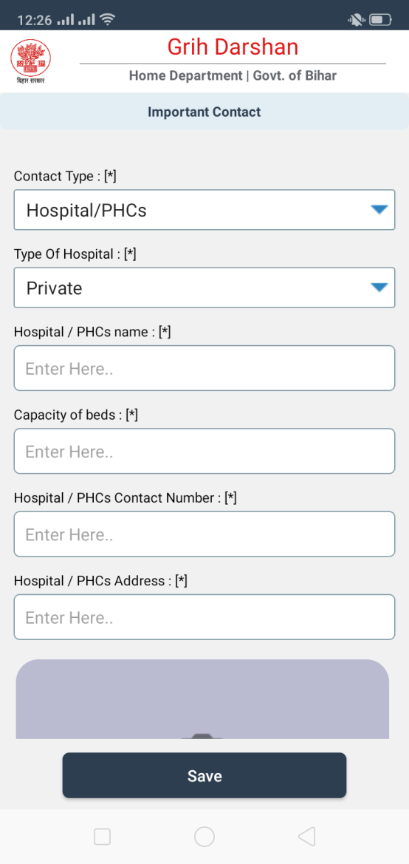
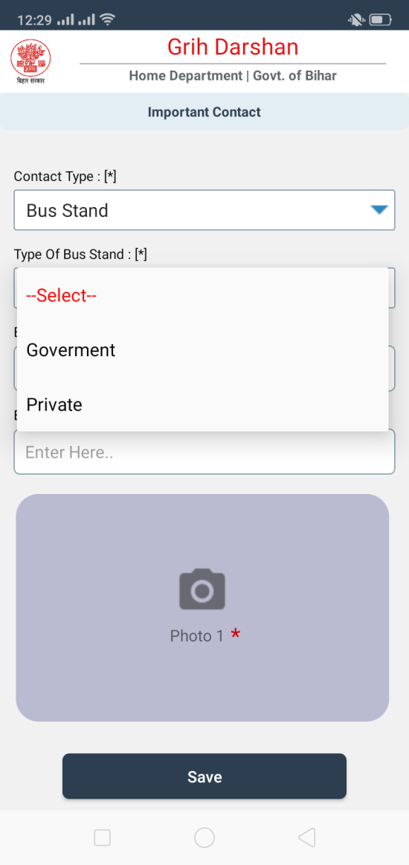
ADD Important Contacts

Slide 10
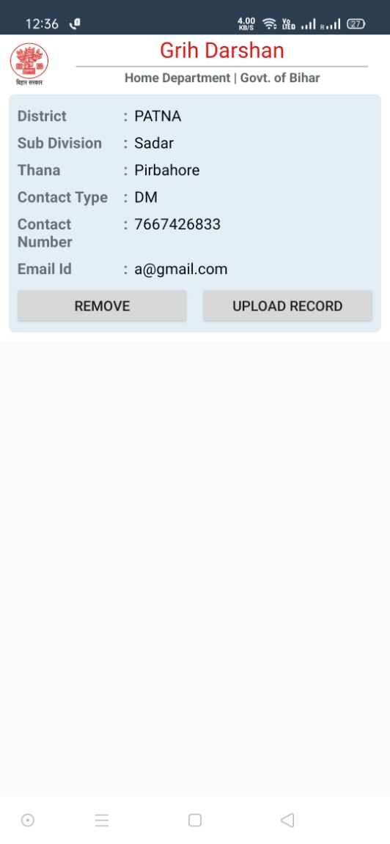
UPLOAD Important Contacts
Click On Upload Button To Upload Record To Server.
Click On Remove Button To Remove Record From Local.

Slide 11
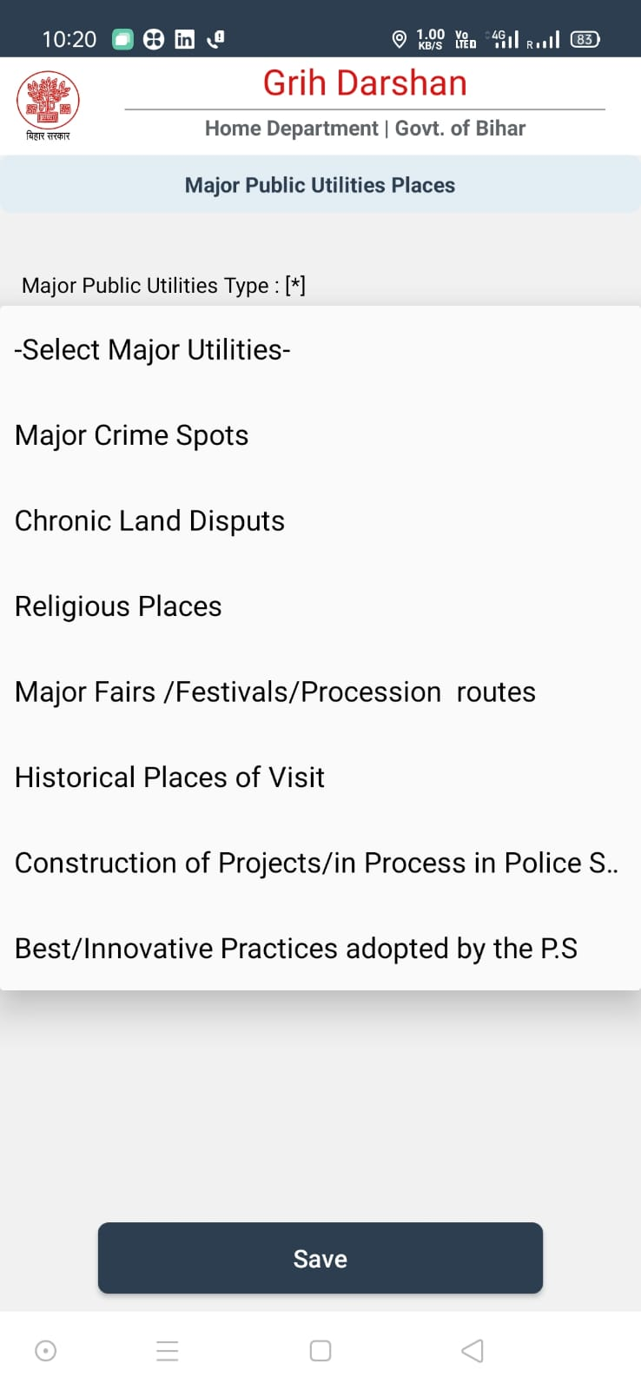
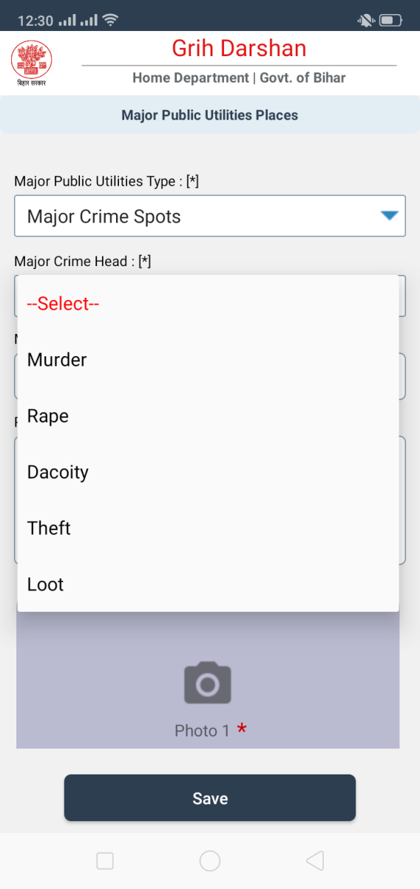
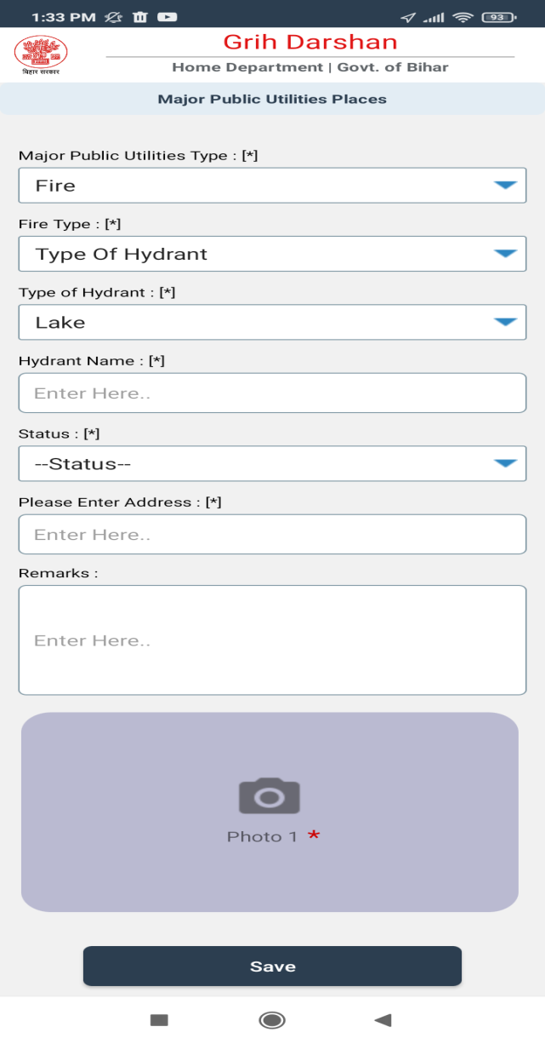
ADD Major Public Utilities Places

Slide 12
Major Public Utilities Places
Minimum 4 Critical Points of Boundary needs to be captured in Religious Places and Major Fair Festival Routes .

Slide 13
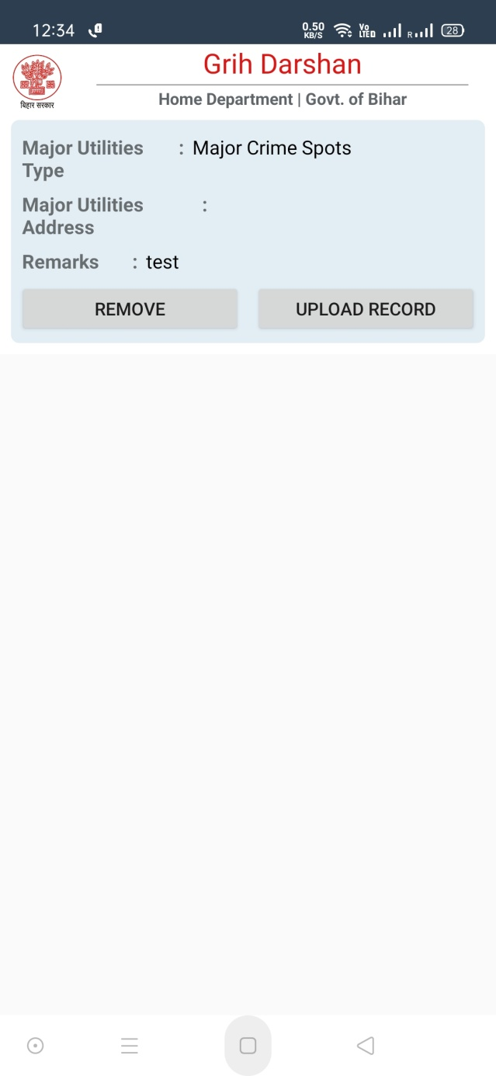
UPLOAD Major Public Utilities Places
Tap on upload records to upload inspected records to server .

Slide 14
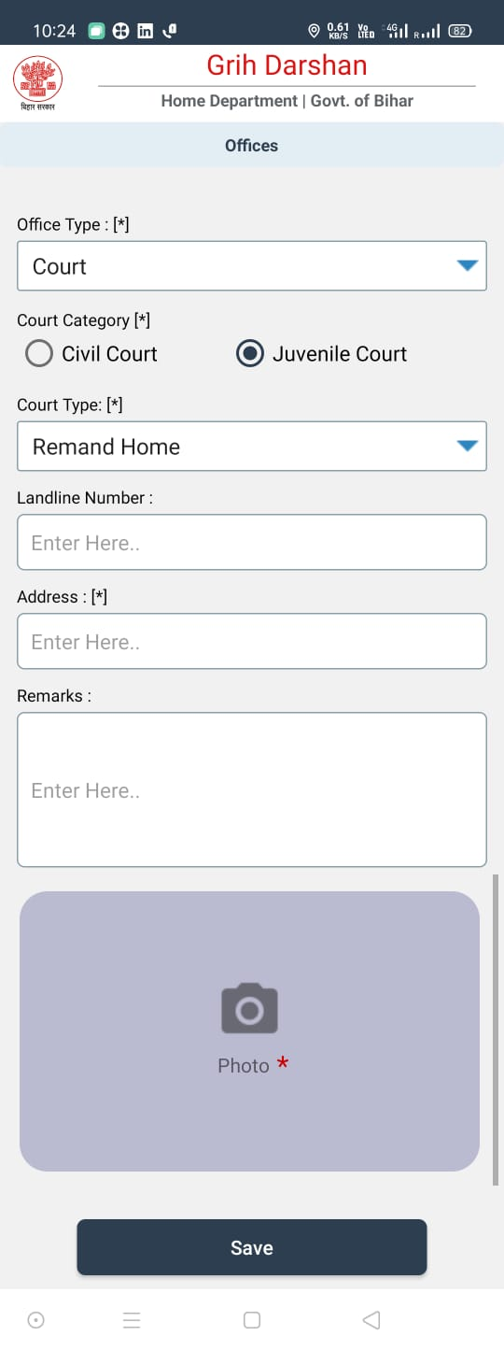
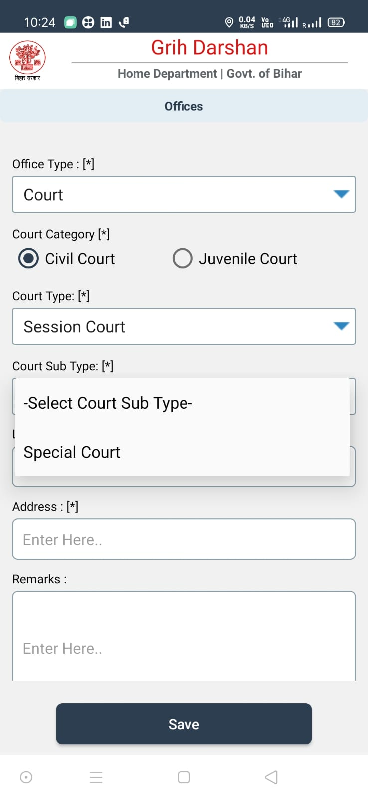
ADD Offices

Slide 15
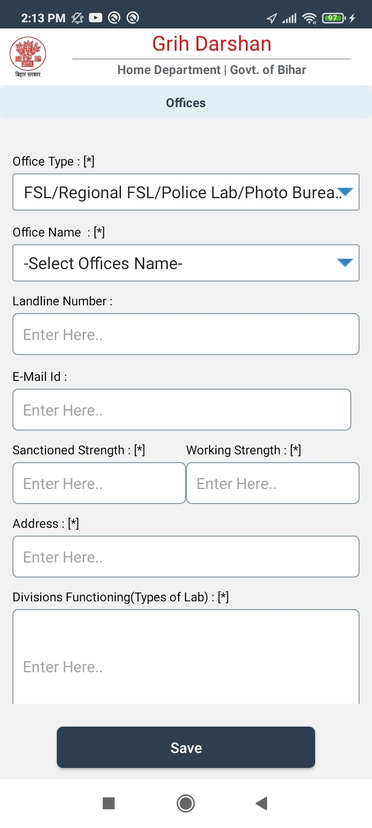
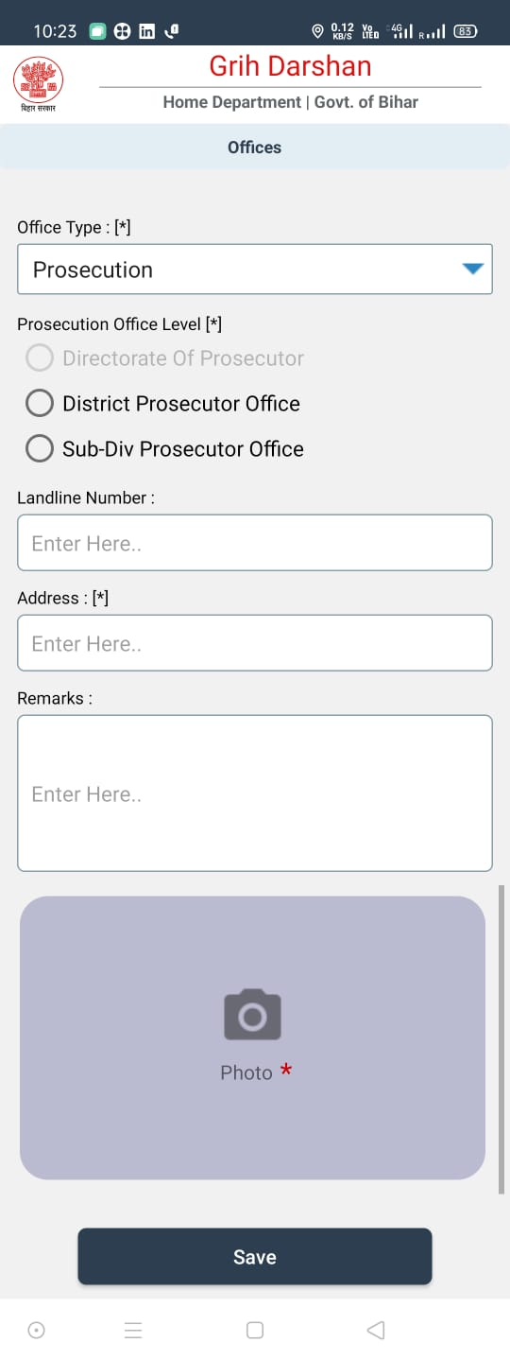
Add Offices

Slide 16
Add Offices
Minimum 4 Critical Points of Boundary needs to be captured in Police Lines.

Slide 17
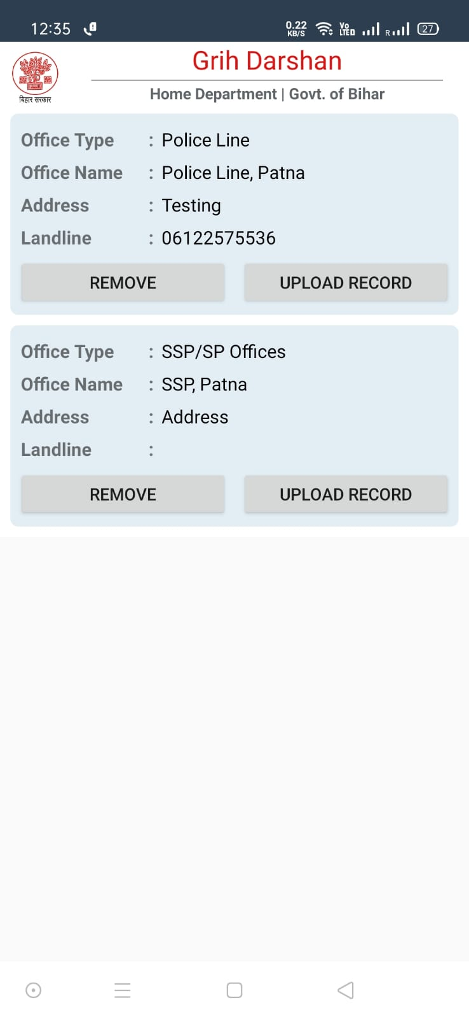
Upload/Remove Offices
Click on “UPLOAD RECORD” To Upload Record to server.
Click on “REMOVE” To Delete Record.

Slide 18
FIRE LOGIN

Slide 19
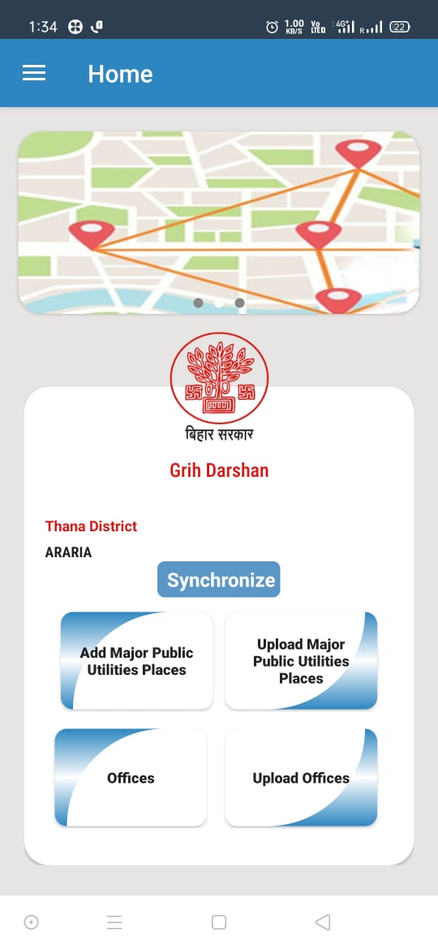
HOME

Slide 20
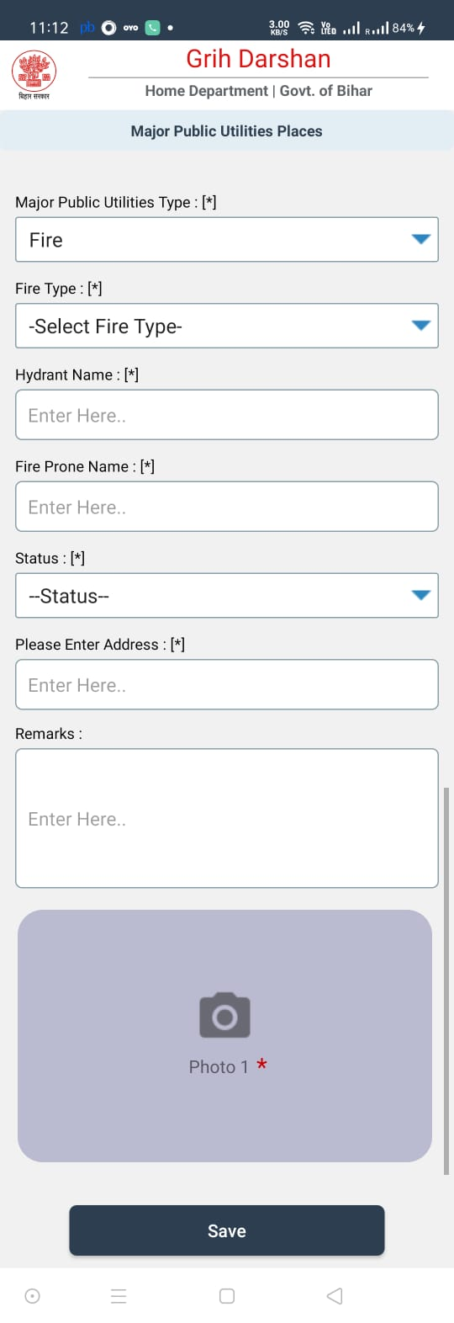
ADD MAJOR UTILITIES FIRE

Slide 21
PRISON LOGIN

Slide 22
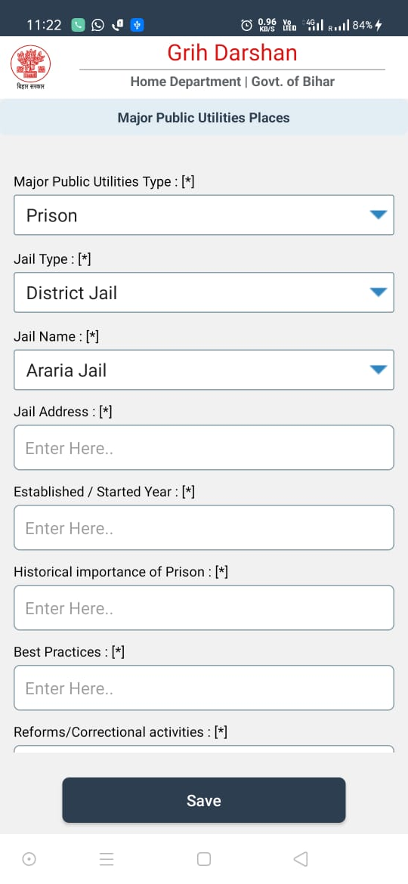
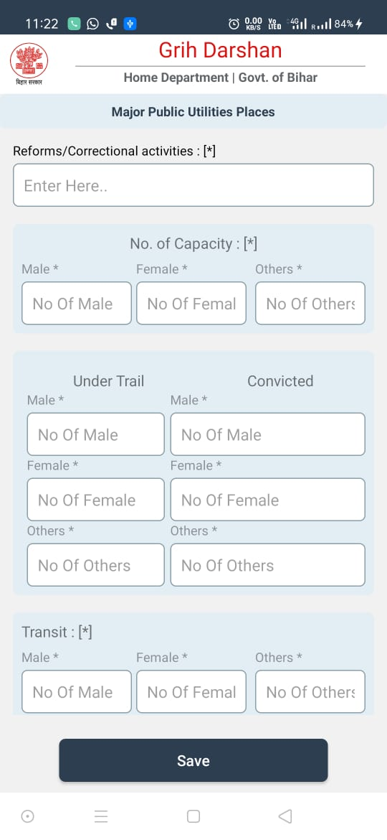
ADD MAJOR UTILITIES PRISON

Slide 23
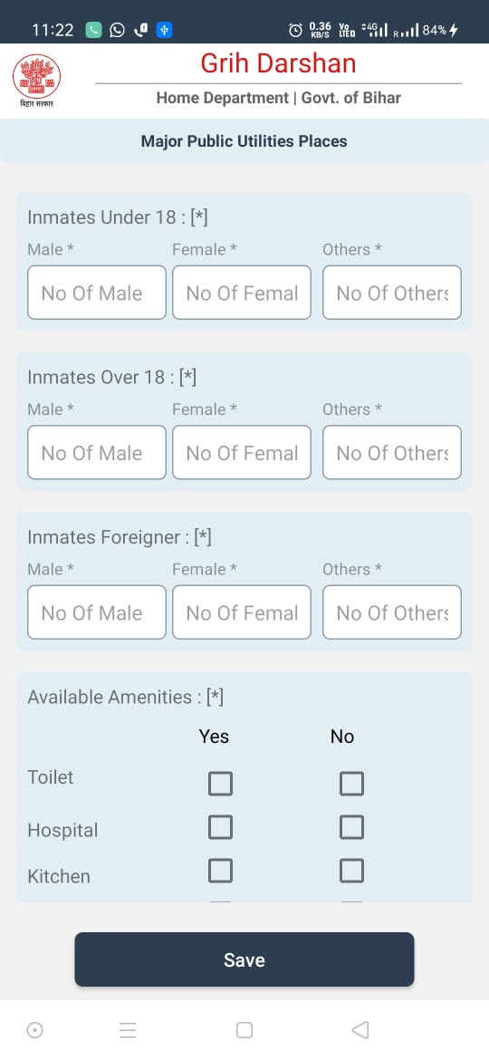
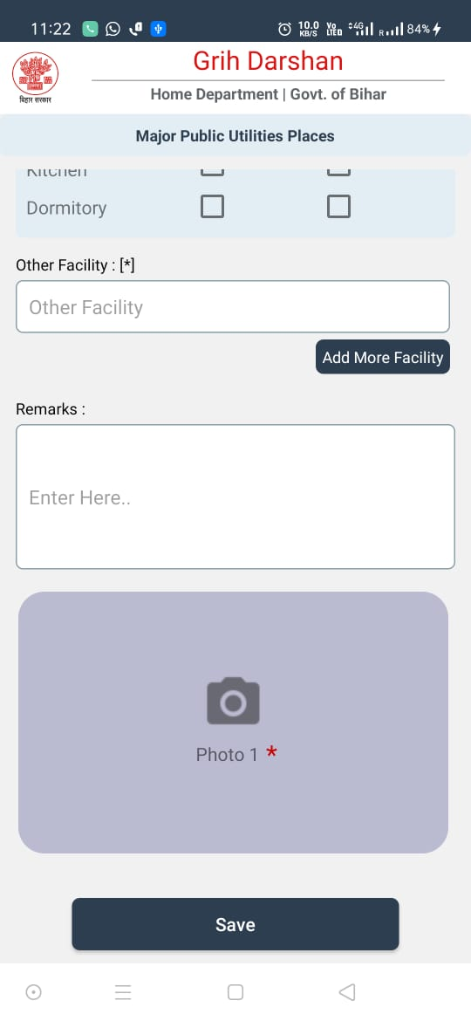
ADD MAJOR UTILITIES PRISON
User can add multiple facilities by clicking on add more facilities

Slide 24
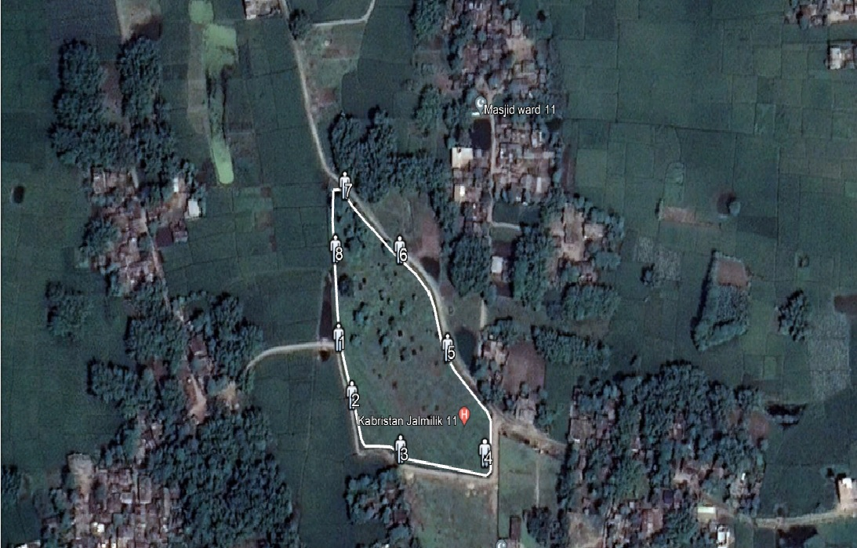
Kabristan

Slide 25
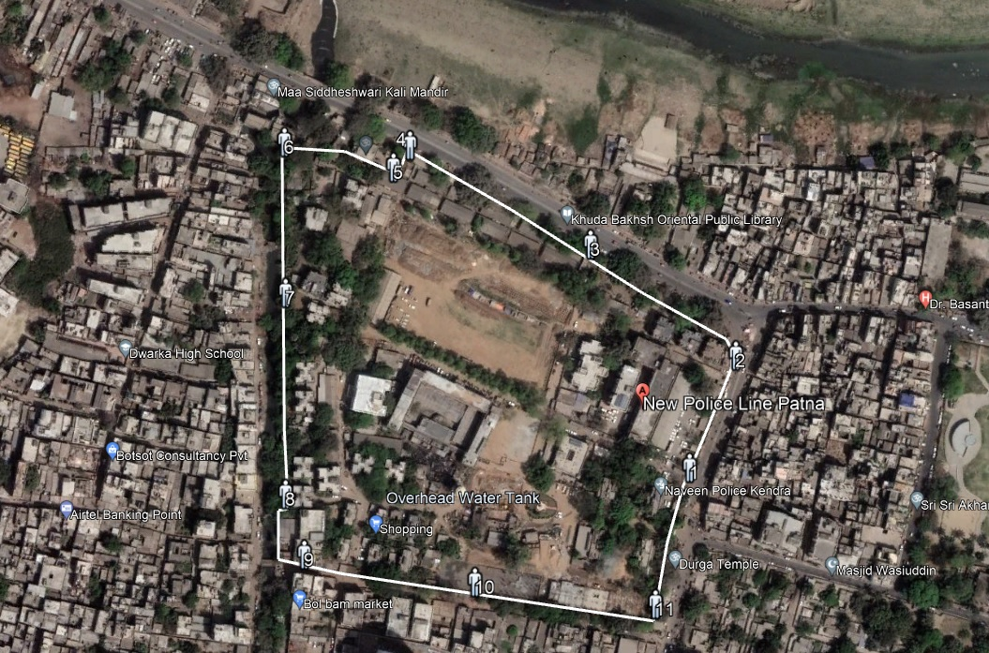
Police Line

Slide 26
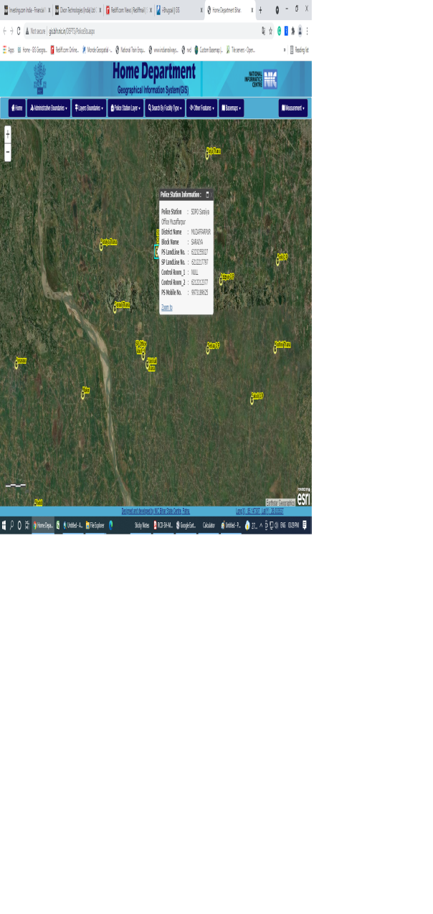
Police Station

Slide 27
Thanks

